Slide 1



SYNTAX SPRINT HACKATHON
powered by: SUNSTONE GD, GOENKA UNIVERSITY
PROJECT TITLE:
PHARMATRACK
A DRUGS INVENTORY MANGEMENT SYSTEM

Slide 2







Our Team MEMBERS
ANKIT VISHWAKARMA
ADITYA SINGH BAGHEL
SHREENATH MAHTHO
MANDEEP KUMAR
TEAM LEADER
FRONTEND DEVELOPER
BACKEND DEVELOPER
FRONTEND DEVELOPER

Slide 3
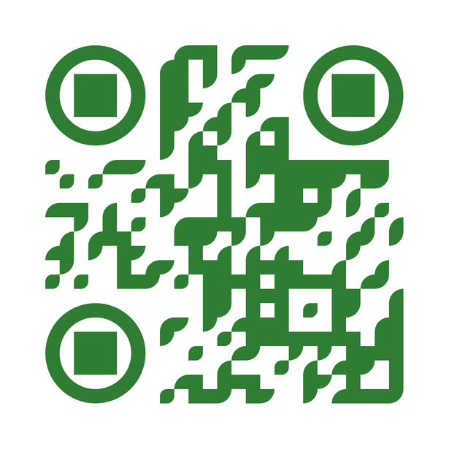
PROJECT LINK:
https://pharmatrack-dacac3.netlify.app
SCAN THE QR TO ENTER THE PROJ ECT

Slide 4
PROBLEM STATEMENT
Inventory management So, let’s move from the traditonal inventory management system and design a smart inventory management system. This system will help Medical shops and distributors to maintain a regular supply of important drugs and medicine. The IMS will let the shop owners know about the expiry of the medicines and as well as distributors regarding the stock. So, this applicaƟon is going to help both distributors as well as shop owners to manage their inventory in sync. You can develop this applicaton and deploy it in cloud services like AWS, and Azure.

Slide 5
INTRODUCTION:
PharmaTrack – The Drugs Inventory Management System
PharmaTrack is a comprehensive inventory management system designed to streamline the tracking, storage, and distribution of pharmaceutical products. It ensures real-time stock monitoring, expiration tracking, and automated restocking alerts, helping pharmacies, hospitals, and medical suppliers maintain efficiency and compliance. With an intuitive interface and robust reporting features, PharmaTrack optimizes inventory control, minimizes wastage, and enhances operational workflow in the pharmaceutical sector

Slide 6
APPROACH:
The Drugs Inventory Management System is designed to streamline pharmaceutical inventory tracking, ensuring efficient stock management, reducing wastage, and preventing shortages. The system leverages a database to store drug details, including batch numbers, expiry dates, and supplier information. It integrates barcode scanning for quick stock updates and real-time monitoring of inventory levels. Automated alerts notify users of low stock and approaching expirations, minimizing risks of stockouts and wastage. Additionally, role-based access control ensures security while enabling pharmacists, suppliers, and administrators to manage inventory effectively. With a user-friendly interface and data analytics for demand forecasting, PharmaTrack enhances operational efficiency and ensures seamless pharmaceutical supply chain management.

Slide 7
IMPACT & BENEFIT
The Drugs Inventory Management System plays a crucial role in ensuring the efficient and accurate tracking of pharmaceutical stock, reducing errors, and preventing drug shortages or overstocking. By automating inventory processes, it minimizes manual intervention, thereby lowering the risk of human errors and ensuring compliance with healthcare regulations. This system enhances patient safety by ensuring that essential medications are always available and that expired or counterfeit drugs are promptly identified and removed. Additionally, it improves operational efficiency for pharmacies, hospitals, and pharmaceutical companies by optimizing supply chain management, reducing wastage, and lowering costs. Real-time monitoring and predictive analytics help in demand forecasting, enabling better decision-making and resource allocation. Ultimately, the Drugs Inventory Management System fosters a more streamlined, transparent, and reliable pharmaceutical distribution network, leading to improved healthcare services and better patient outcomes.

Slide 8
FUTURE SCOPE
The future scope of PharmaTrack – The Drug Inventory Management System is vast, with numerous opportunities for innovation and scalability. As the pharmaceutical industry continues to evolve, the system can integrate AI-powered demand forecasting to predict stock requirements accurately, reducing wastage and ensuring continuous availability of essential medicines. Blockchain technology can enhance transparency and security in the supply chain, preventing counterfeit drugs from entering the market. The implementation of IoT-enabled smart inventory tracking can enable real-time monitoring of drug storage conditions, ensuring compliance with regulatory standards. Additionally, expanding the platform to include automated order placement and real-time distributor synchronization will streamline operations for pharmacies and distributors. Future enhancements could also include mobile application integration for remote access, machine learning-driven sales insights, and regulatory compliance automation to help businesses stay ahead of changing pharmaceutical policies. With continuous advancements in technology, PharmaTrack has the potential to become an all-in-one solution for efficient, secure, and data-driven drug inventory management.

Slide 9
RESEARCH & REFERENCE
A Drugs Inventory Management System is a critical software application designed to streamline the storage, tracking, and distribution of pharmaceutical products in hospitals, pharmacies, and healthcare facilities. Effective inventory management ensures that essential medications are available when needed, reduces wastage due to expired drugs, and prevents stock shortages. The system typically incorporates real-time tracking, automated alerts for low stock levels, and batch tracking to monitor drug expiration dates. Advanced systems may integrate with electronic health records (EHRs) and supply chain networks for seamless coordination. According to a study by Chilingerian et al. (2020), efficient drug inventory systems significantly reduce medication errors and enhance patient safety. Furthermore, research by World Health Organization (WHO, 2019) emphasizes that computerized inventory management systems help mitigate financial losses by optimizing procurement and storage processes. Technologies such as RFID (Radio Frequency Identification) and barcode scanning are widely used to improve accuracy in inventory tracking. The adoption of AI and predictive analytics in modern inventory systems enhances forecasting capabilities, ensuring optimal stock levels based on demand patterns. In conclusion, implementing a Drugs Inventory Management System is crucial for healthcare institutions to enhance operational efficiency, ensure regulatory compliance, and provide uninterrupted patient care.

